Slide 1
Computational Quantum Mechanics
Prof. Gerson J. Ferreira
INFIS/UFU 2020/1
Root finding algorithms
https://gitlab.com/gersonjferreira/computational-quantum-mechanics

Slide 2
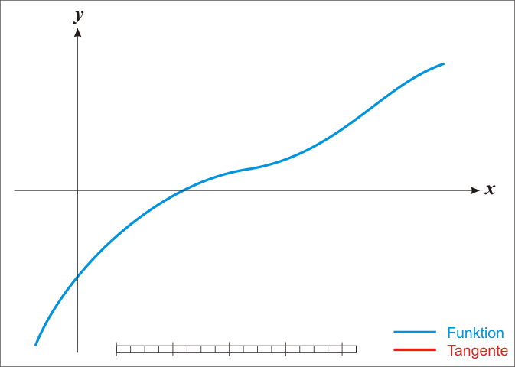
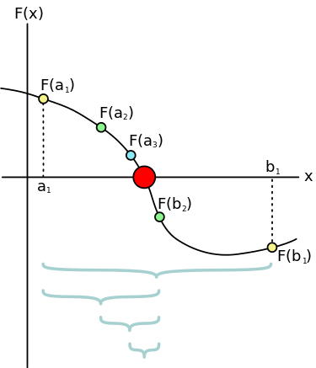
Outline
Root finding algorithms → sin(x) = αx, x = ?
→ Newton’s method and the Secant method
→ Bisection method
→ … more at the [Wikipedia] and the books in the class bibliography
Why?
→ We’ll need one of these to solve Schrödinger’s equation with shooting methods
[images from Wikipedia]

Slide 3


Newton’s method
We want to find x such that f(x) = 0.
Let’s guess that there’s a solution at x=x0, and expand f(x) for x near x0.
A better estimate for the root might be...
Now repeat the expansion for x near x1, and iterate to get
This method assumes you have an analytical expression for the derivative f’(x)

Slide 4
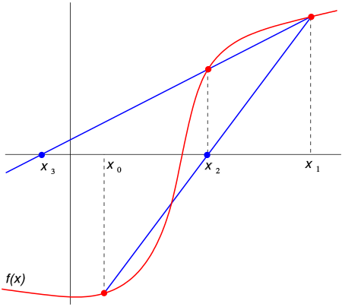
The secant method
Starting with Newton’s method
… but not let’s assume we don’t have f’(x)
Replace f’(x) with a finite differences derivative
Derivation at [Wikipedia]

Slide 5
The bisection method
If there’s a (single) root F(x) = 0 in the interval a < x < b,
→ F(a) F(b) < 0
1. Take the midpoint c = (a+b)/2.
2. If F(a)F(c) < 0, switch to the interval a < x < c.
If F(c)F(b) < 0, switch to the interval c < x < b.
3. Repeat until convergence (interval small enough)

Slide 6
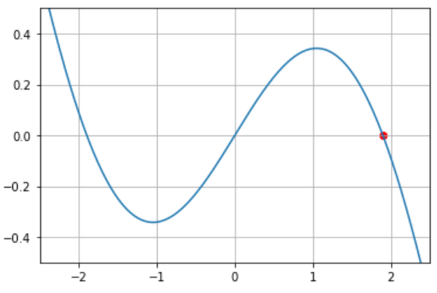
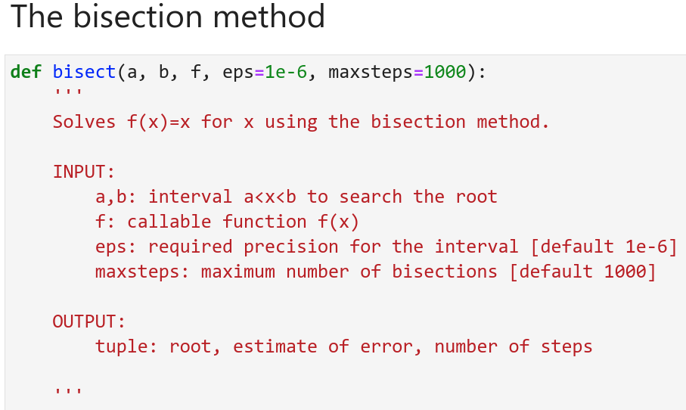
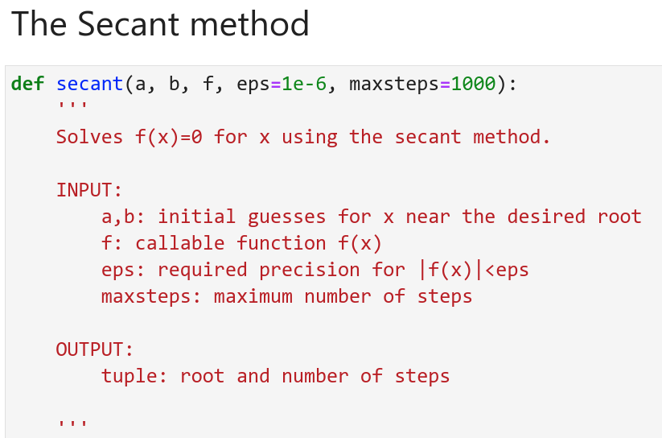
Examples and implementation at the course webpage
Suggestion, use Scipy:
from scipy import optimize
→ newton
→ bisect

